Slide 1




Number Guessing Game
Prepared by :-
Name : Monpara Romil Kamleshbhai
Roll No. :- 328
Enrollment No. :- 23002170210064
Batch : D-11 Branch : IT
Unlock the Mystery.

Slide 2

Game Objective
The objective of the game is to guess a randomly generated number within a specified range.

Slide 3
How to Play
1.
The player needs to input their guess.
2.
The player will receive feedback on whether the guess is too high or too low.
3.
The player continues guessing until they guess the correct number.

Slide 4

Game Features
A scoring system is implemented to track the player's performance and provide feedback on their accuracy and efficiency.

Slide 5
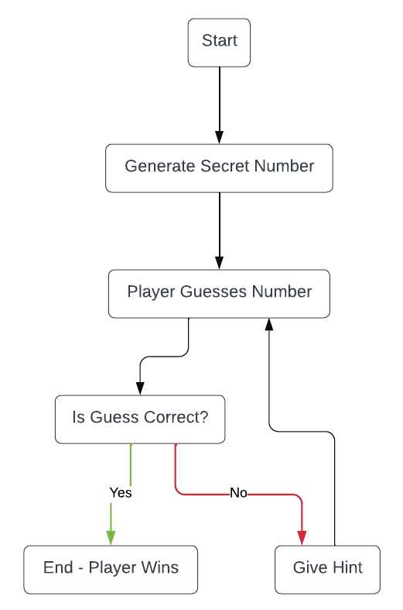
Flowchart

Slide 6

Tips and Strategies
Start with the middle number in the range. This will help you quickly narrow down the possibilities and eliminate half of the numbers.
Use the feedback from each guess to further narrow down the possibilities. If the feedback indicates that the number is higher, focus on the higher half of the remaining numbers.
Keep track of your previous guesses. This will help you avoid repeating numbers and make more informed guesses.

Slide 7
Enjoy The Game. . .
Thank you. . .

